Slide 1


Slide 2
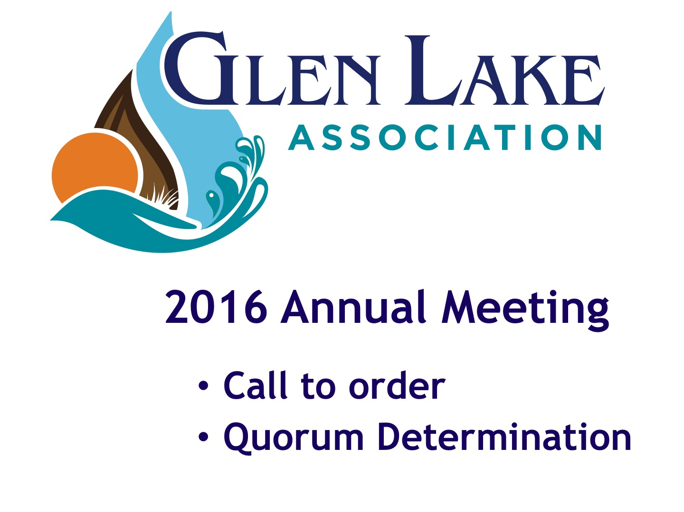

Slide 3
Meeting Agenda
Present financials
Review programs to manage swimmer’s itch
Introduce new GLA logo and website
Review Committee activities
Recognize outstanding contributions
Elect new Directors
Answer Q&As
Notes:
Thank you for coming today…we will have a short business meeting, and then we will give you time to visit the displays and talk to the experts around the room who can give you great insight into the projects we support.

Slide 4
Your Glen Lake Association
Officers and Board of Directors
Officers
Denny Becker - President
Bill Witler -Vice President
Sue Lake - Secretary
David Herr - Treasurer
Other Directors
Bob Boles Cal Killen
Cara Cassard John DePuy
David Hayes Ranae Ihme Bill Meserve

Slide 5
Introductions
Staff-Rob Karner & Sallyanne Morris
Parliamentarian-Chuck Barnell
Proctors
  - Sue Dutmers
  - Barb LeJeune
  - Robert Novak
Notes:
Thank you for coming today…we will have a short business meeting, and then we will give you time to visit the displays and talk to the experts around the room who can give you great insight into the projects we support.

Slide 6
2015 Annual Meeting Minutes
Motion to accept the
2015 Annual Meeting Minutes
Notes:
Thank you for coming today…we will have a short business meeting, and then we will give you time to visit the displays and talk to the experts around the room who can give you great insight into the projects we support.

Slide 7
Finance and Investment Committee
David Herr– Chair
Peter Anderson
Andy DuPont
Jim Good
John Hoagland
Gary Humphreys
Charles Ofenloch
Roy Pentilla
Kurt Rivard

Slide 8
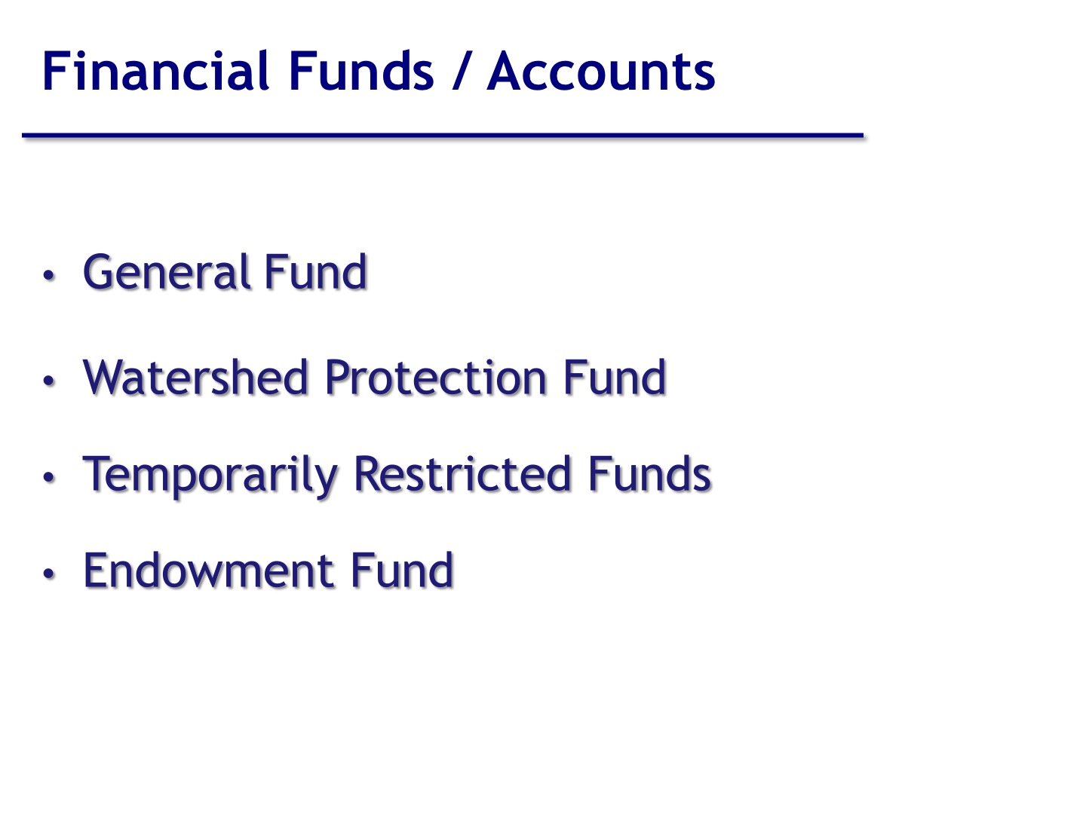

Slide 9
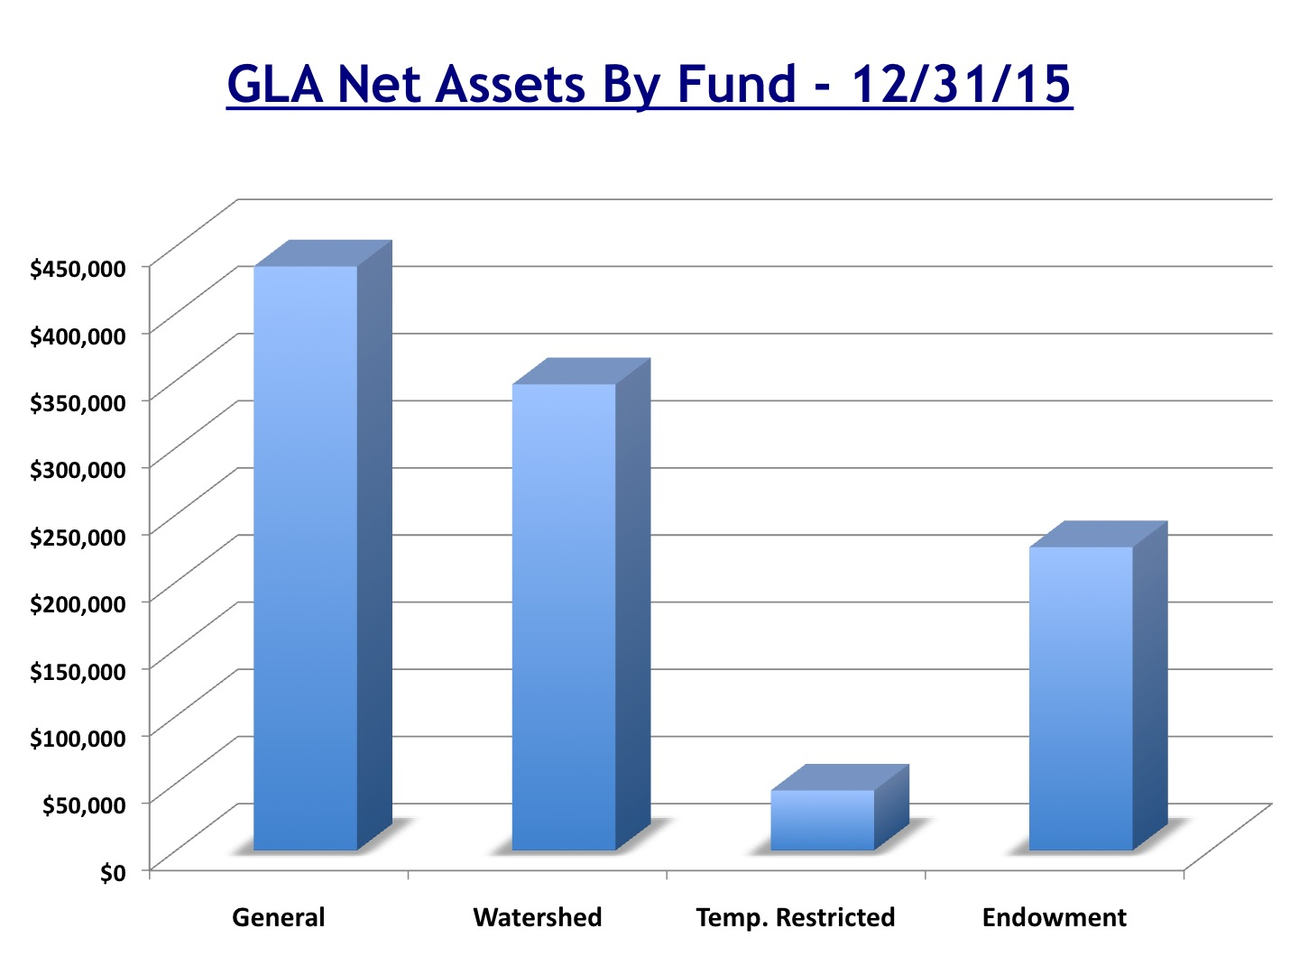

Slide 10
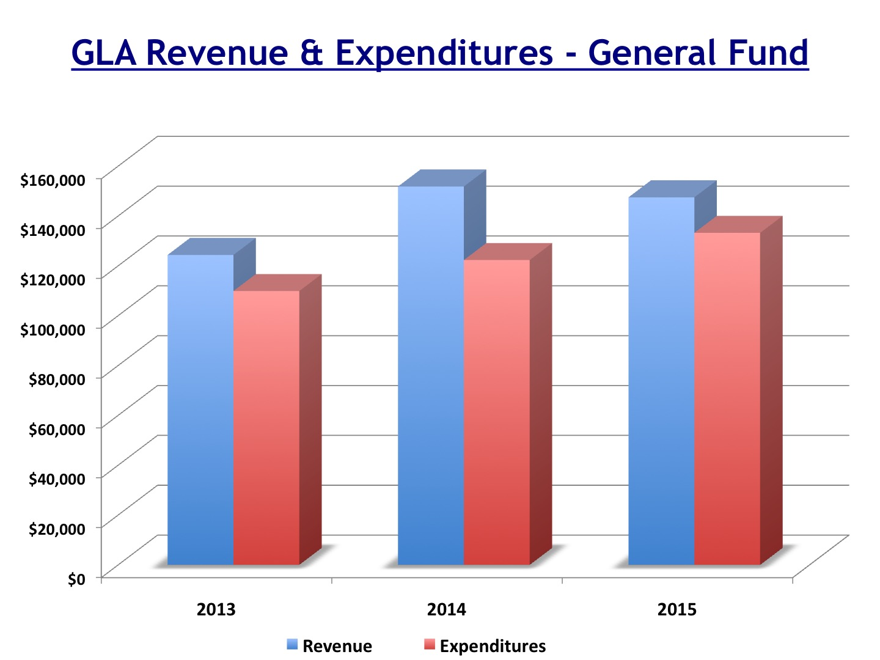

Slide 11
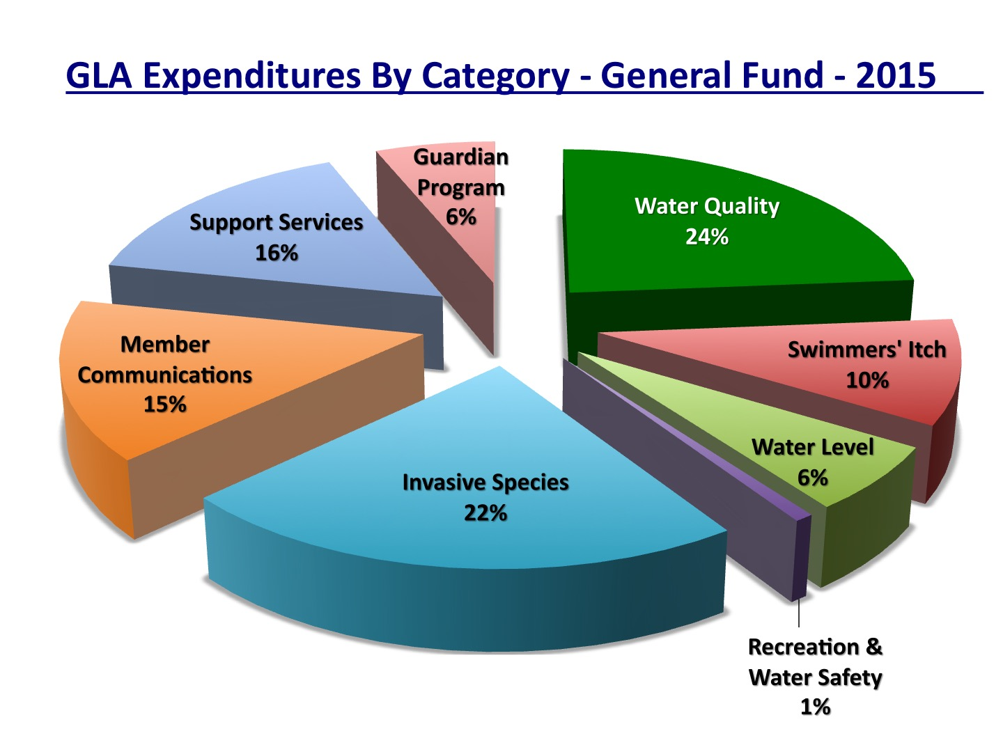

Slide 12
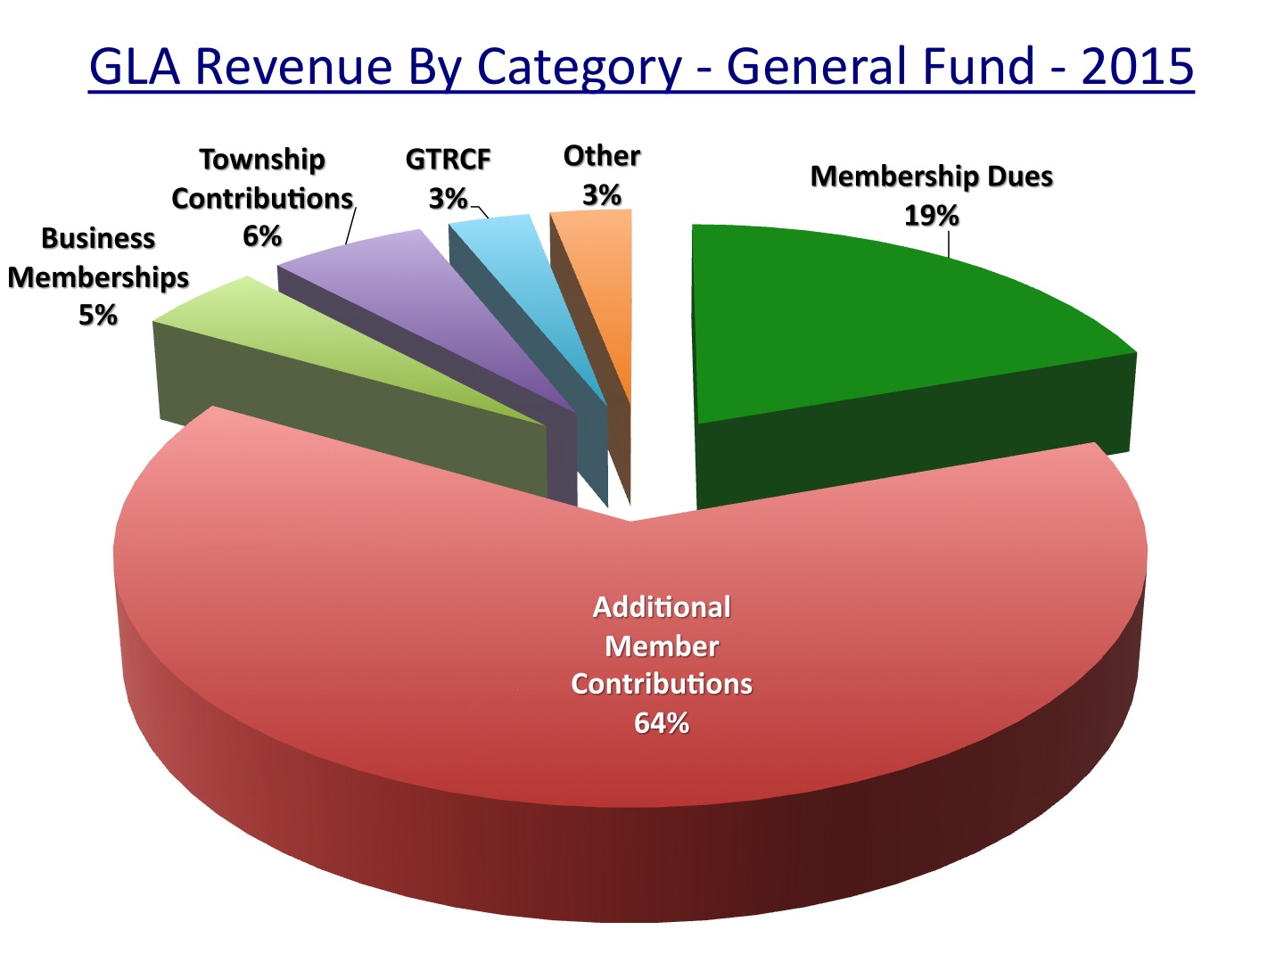

Slide 13
Financial Report
Motion to accept the Financial Report
Notes:
Thank you for coming today…we will have a short business meeting, and then we will give you time to visit the displays and talk to the experts around the room who can give you great insight into the projects we support.

Slide 14
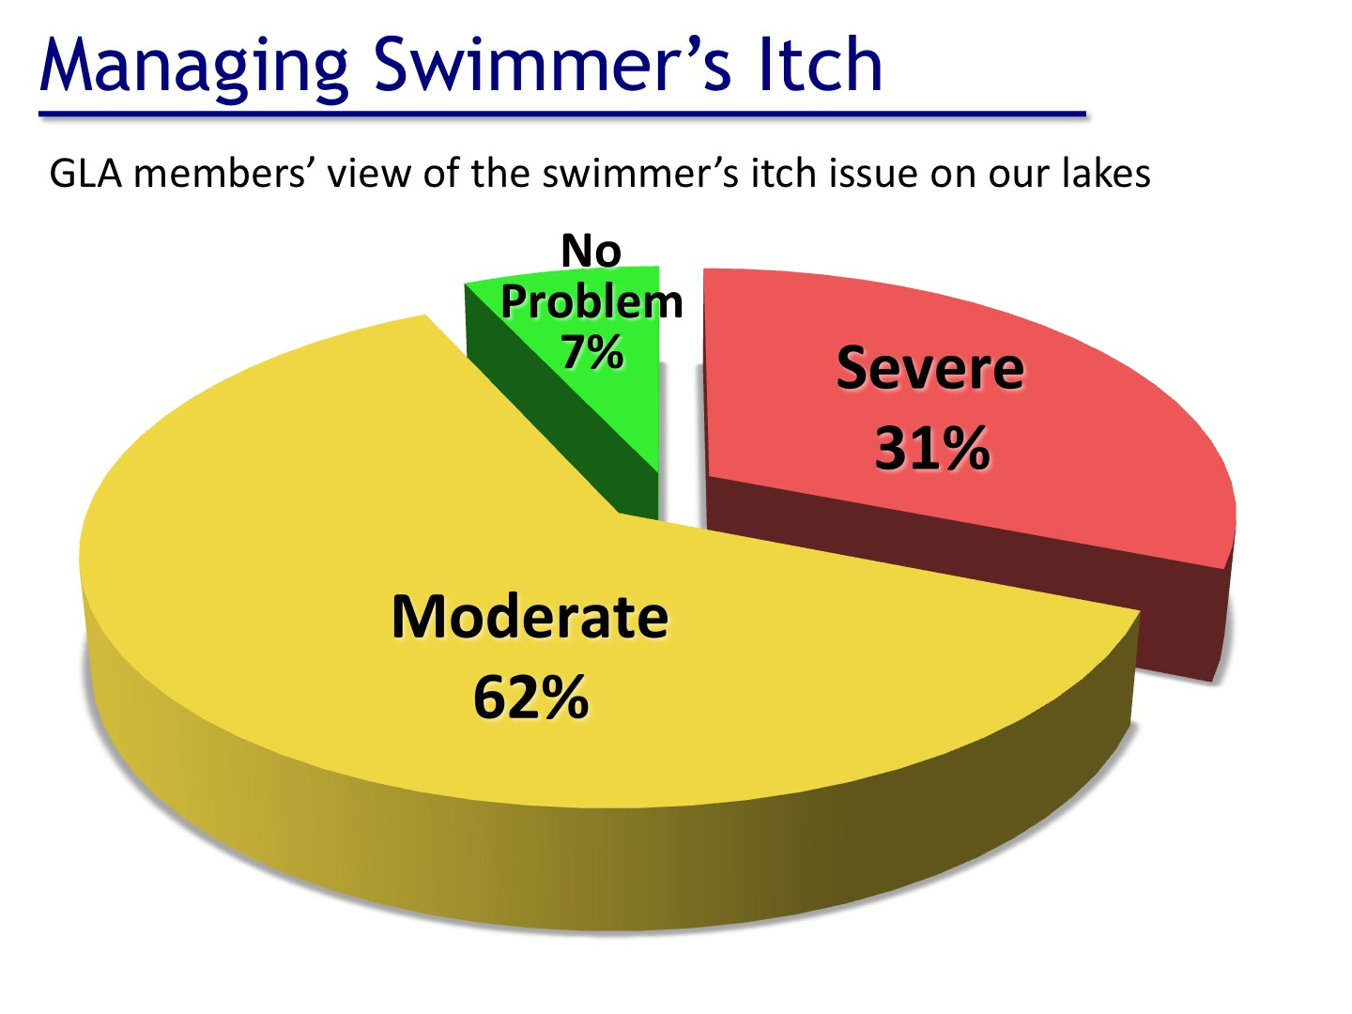

Slide 15
Swimmer’s Itch Report
by Rob Karner, M.S.
Watershed Biologist

Slide 16
Brief History
First 30 years - Kill all snails with copper sulfate
80’s and 90’s - Research & Experimental Trapping of Common Mergansers
2004 to 2009 - Perfect Control Methods

Slide 17
Harassment Breakdown
2010-2014 - appearance of success keeping merganser broods at one to two broods
2015 - loosing grip on success with three merganser broods and 27 chicks
2016 - out of control with seven broods and 61 chicks

Slide 18
Results History
50’s to 70’s - itch still prevalent and snails repopulate
80’s to 90’s - snail infection rates went down
2004 to 2009 - snail infection rates consistently low
2015 to 2016 - Higgins Lake replicates GLA Lakes

Slide 19
Partership is Born
Michigan Swimmer’s Itch Partnership (MSIP) is formed in 2014
25 Lake Associations
GLA supports lobby effort at state level

Slide 20
MSIP Structure
Steering Committee - GLA represented
Leelanau Center for Education is home of MSIP
Susan Price is project manager
$250K for first year with two additional years of funding expected

Slide 21
Oakland University
Partner in itch study - in second year
Trying to use environmental conditions to predict itch levels
Lake to lake comparisons - Glen Lakes in middle
Will evaluate 2016 results and consider a third year of study in 2017

Slide 22
SiCon, LLC
Historic partner with GLA in itch research, control, and education since 1985
Current work in Higgins Lake
Nesting sites of mergansers is now a new focus
Possible return to Glen Lake in 2017

Slide 23
Riparian Help Needed
Reporting of itch cases on GLA website
Oakland University - volunteers needed
Swim smart and protect yourself
Harassment volunteers

Slide 24
Predictions
Change in state permit structure
MSIP will continue to get stronger
Live trapping will reduce itch cases but itch will not be eradicated
Itch creams will get better
GLA will need to supplement state funding

Slide 25
GLA Plans for 2017
Suspend spring harassment to accommodate focus on nest sites
Live trap all broods off the lake
Continue to support lobby effort
Continue fall harassment of mergansers

Slide 26
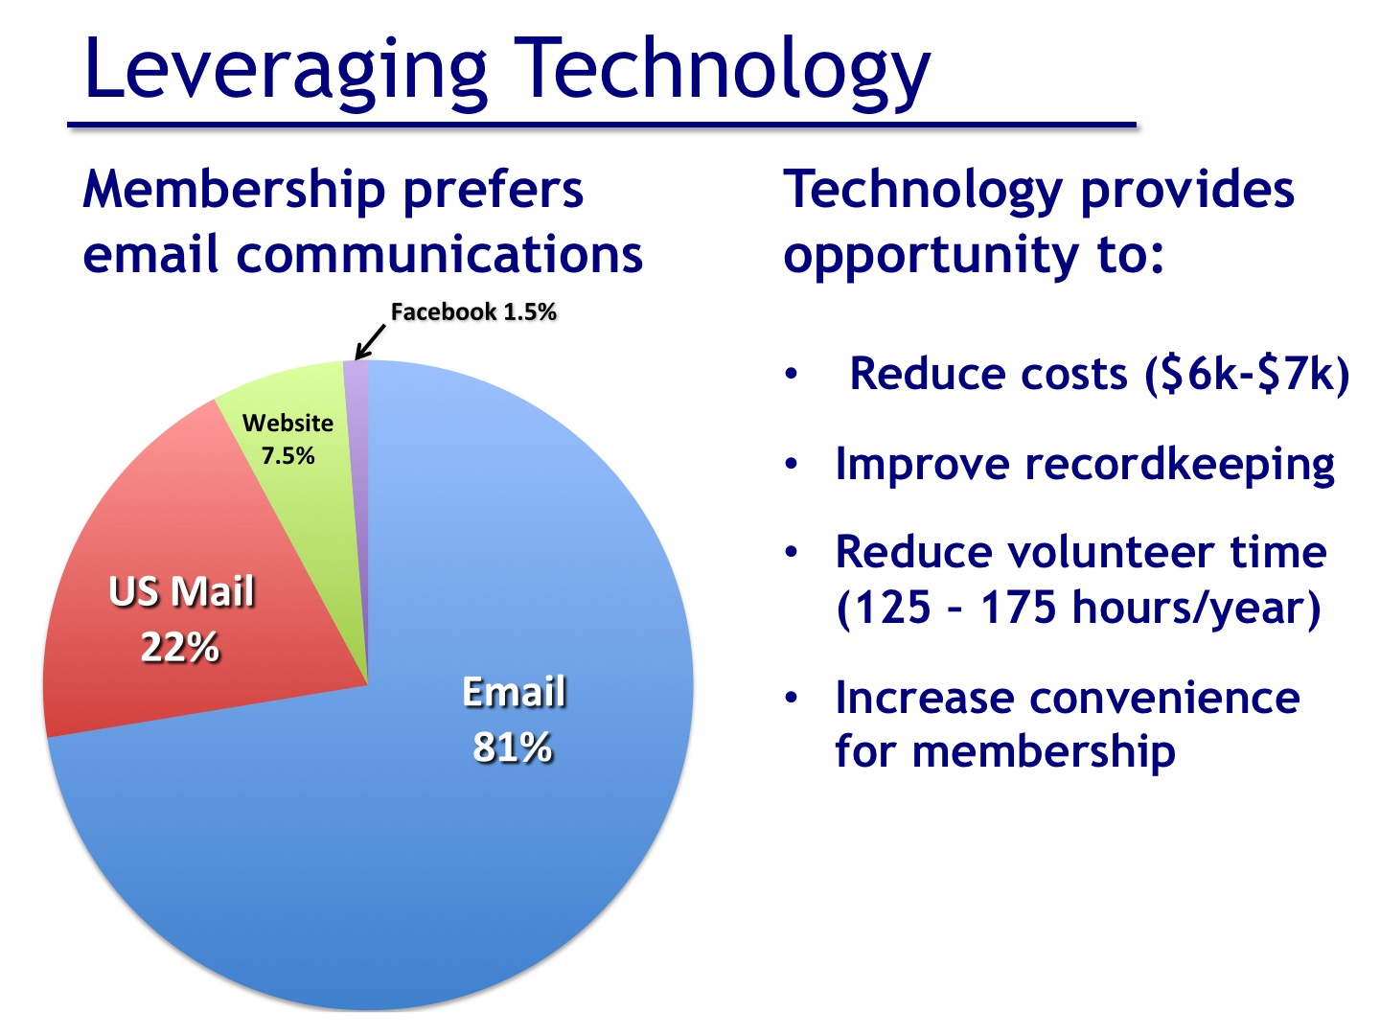

Slide 27
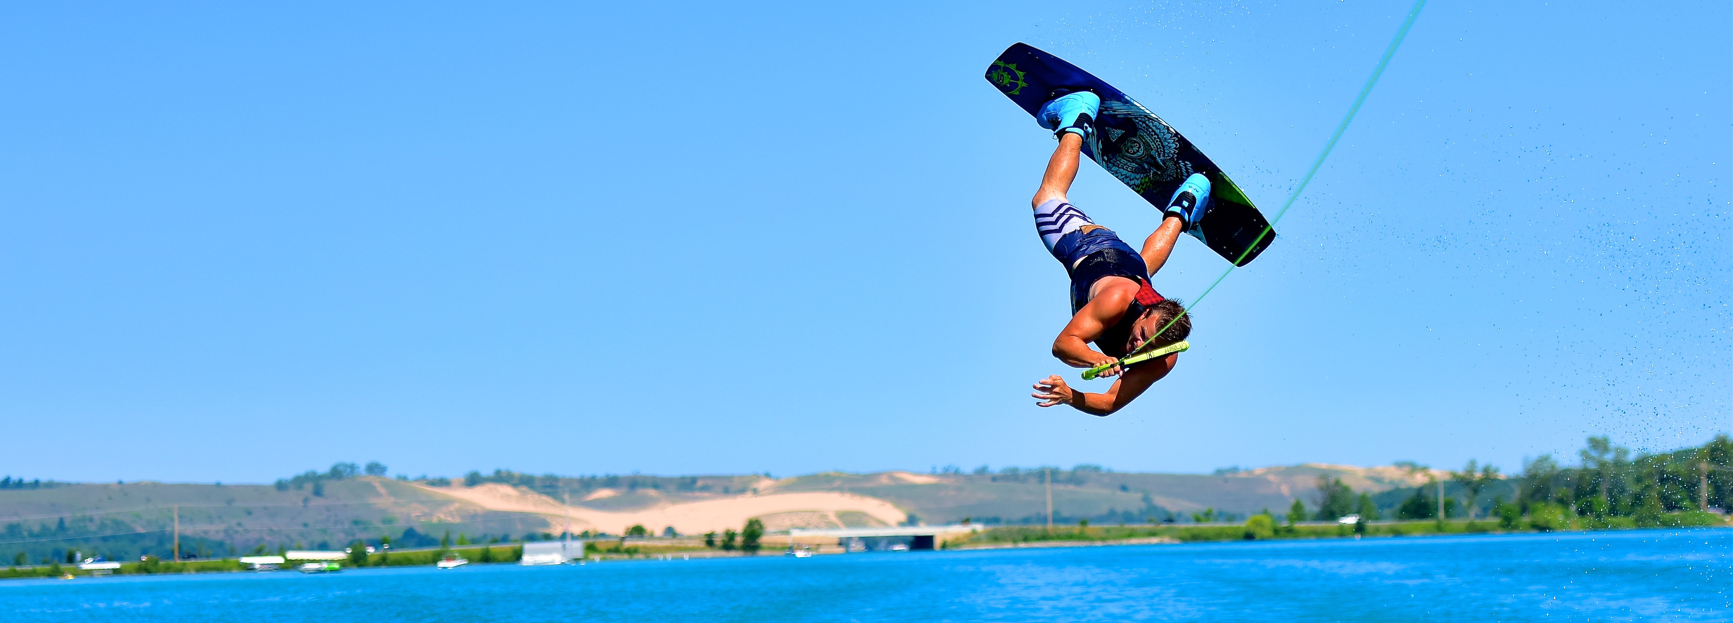
Glen Lake Association
has a new look

Slide 28

Introducing our new logo

Slide 29
The yellow circle
represents the sun.

Slide 30
The yellow circle
represents the sun.
The light blue represents
the sky or air.

Slide 31
The yellow circle
represents the sun.
The light blue represents
the sky or air.
The brown represents the land within the Watershed

Slide 32
The yellow circle
represents the sun.
The light blue represents
the sky or air.
The brown represents the land within the Watershed
Finally, the base of our logo, the turquoise, represents the water, which is what makes Glen Lake so amazingly beautiful.

Slide 33
The story of the Glen Lake Association today and in the distant future is much about protecting and preserving the water but it is more than that.
We believe that our new logo mirrors the association’s efforts to broaden our umbrella of protecting and preserving not only the water
(“It’s all about the water”),
but it is including the entire watershed as well.

Slide 34
We are a well-established lake association (over 50 years old)
    We are progressive (named Best Lake Association in Michigan 2011)
    We are the protectors of Glen Lake and its Watershed

Slide 35
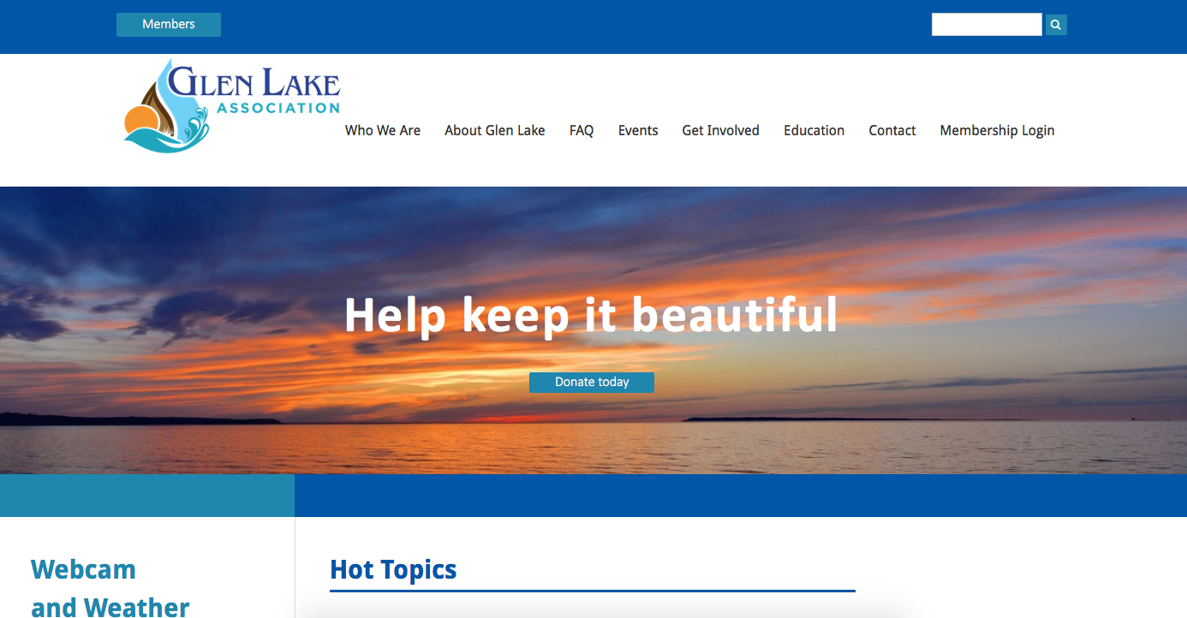
Welcome to our new website

Slide 36

Our new website will help you:
Check event calendar
Explore Hot Topics from around the watershed
Update your profile, address and information in our new
password-protected members area

Slide 37
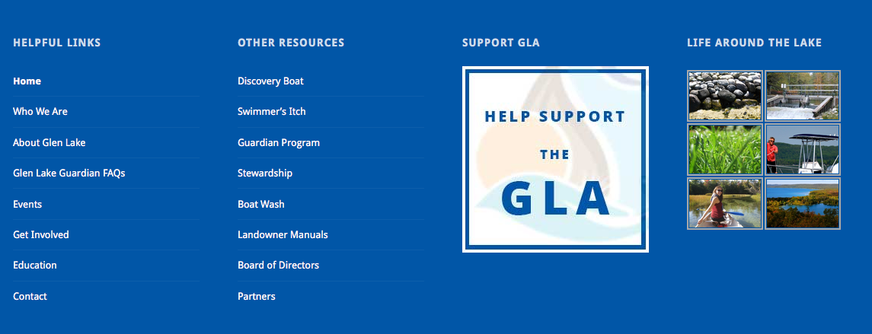
    Our new website will help you:
    Check lake levels and river flow
    Report Swimmer’s Itch
    Find out local weather conditions and view lake webcam

Slide 38
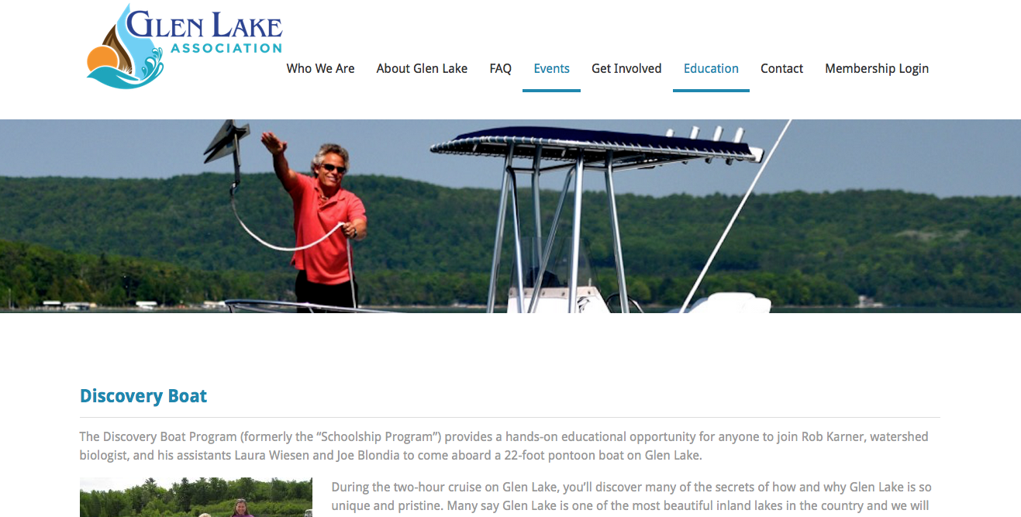
    Our new website lets you:
    Sign up online for Discovery Boat and other workshops
    Become a Glen Lake Guardian online
    Pay your dues online
    Make donations

Slide 39
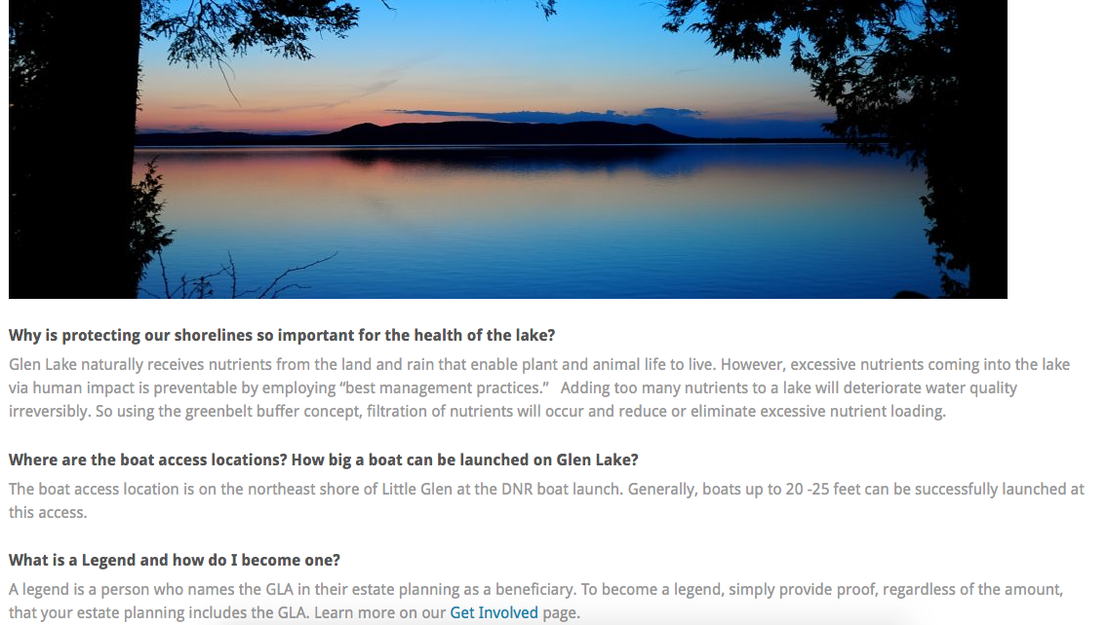
Our new website also features:
An FAQ page
Newsletter archives
An area to submit photos

Slide 40
Have questions or need help with the new GLA website?
Email us at glenlakeassociation@gmail.com
Grab one of our handy brochures

Slide 41
www.glenlakeassociation.org

Slide 42
Committee
Summary
Reports
Notes:
Thank you for coming today…we will have a short business meeting, and then we will give you time to visit the displays and talk to the experts around the room who can give you great insight into the projects we support.

Slide 43
Water Quality Committee
Cal Killen – Chair
  Andy DuPont
  John Hayes
  Rob Karner
  Bruce Lichliter
  Mike Litch
  Sarah Litch
  Barb Lund
  John Lund
  Bill Meserve
  Elaine Pentilla
  Roy Pentilla

Slide 44
Water Quality Approach
“Prevention, Early Detection, and Rapid Response”

Slide 45
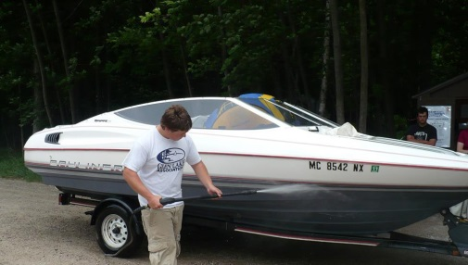
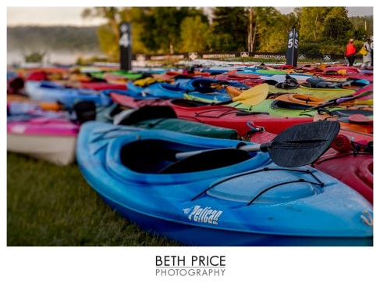
Boat Wash Highlights
Goal: Prevent aquatic invasive species in Glen Lake waters
**PREVENTION – LESS EXPENSIVE THAN ERADICATION**
Washed and Interviewed
  3,004 watercraft total 2015
  1,427 July 20 2016 YTD
2016 M22 Challenge
  603 Kayaks/SUPs
GLA Boat Wash
M22 Challenge

Slide 46
Boat Wash Staff
Manager—Sallyanne Morris
Volunteers
  John DePuy - Chair
  Denny Becker
  Tom Flerlage
  Bruce Lichliter
  Bill Meserve
  Bethany Hight
  Michael Zoyhofski

Slide 47

  “1000’s of people…
  taking small steps…
  make the difference”
Notes:
We launched the Guardian Program in June – one of the biggest campaigns we have ever done. Here’s our Logo: Protecting the watershed, drop by drop.
Let’s talk about protecting the watershed.
Simply put, the things that threaten our lakes and river are Nutrients, Chemicals and Invasive Species.
Nutrients (Phosphorous & Nitrogen) cause plant growth -> organic decay -> oxygen depletion -> aging lake. (a muck pond)
Chemicals & Invasive Species cause similar effects. They can kill the native life (plants & animals) and ruin the balance of nature. (zebra mussels)
There is no way around it. These threats ultimately come from humans. And with increased population and visitors, the threats increase. The only way to protect the watershed is through human involvement. Smokey the Bear said: “Only YOU can prevent forest fires”; the sentiment is the same for Glen Lake.
So the Guardian Program was created to educate the public on what we all can do to protect the watershed.
And it’s not just big things that we need to do – it’s the little things – Drop by Drop. If one person let his septic tank leak into the lake, it would be bad. If we all did it, we’d have a tragedy.
The icon (if you can’t see it) is a picture of person hugging a drop of water – a “water hugger” so to speak. I think it’s a terrific symbol for us.

Slide 48
2016 Guardian Program Initiatives
Expanded program to include lawn service and landscape providers
  Sixteen providers joined program
  Agree to encourage “lake-friendly” best practices and distribute GLA landscaping brochure
Invited non-riparian watershed residents to join program (20 new Guardians to date)
Continued focus on landlords/rental agencies, new riparians and new construction/remodeling

Slide 49
Focus on Septic Systems
Glen Arbor township passed point-of-sale septic ordinance June, 2014
  18 months ending December 2015 resulted in 36 inspections and 8 required interventions to bring systems up to code
  Year-to date results are 21 inspections and 6 require interventions
Empire township focused on education
Share Glen Arbor Township results with neighboring townships

Slide 50
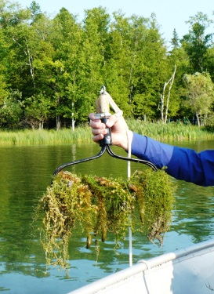
Invasive Species Initiatives
Water Quality members conduct annual invasive plant surveys
No new invasive plants were detected in 2015.
2016 surveys are ongoing.
Coltsfoot eradication efforts continue; please be patient and cooperative
Aquatic Plant
Survey

Slide 51
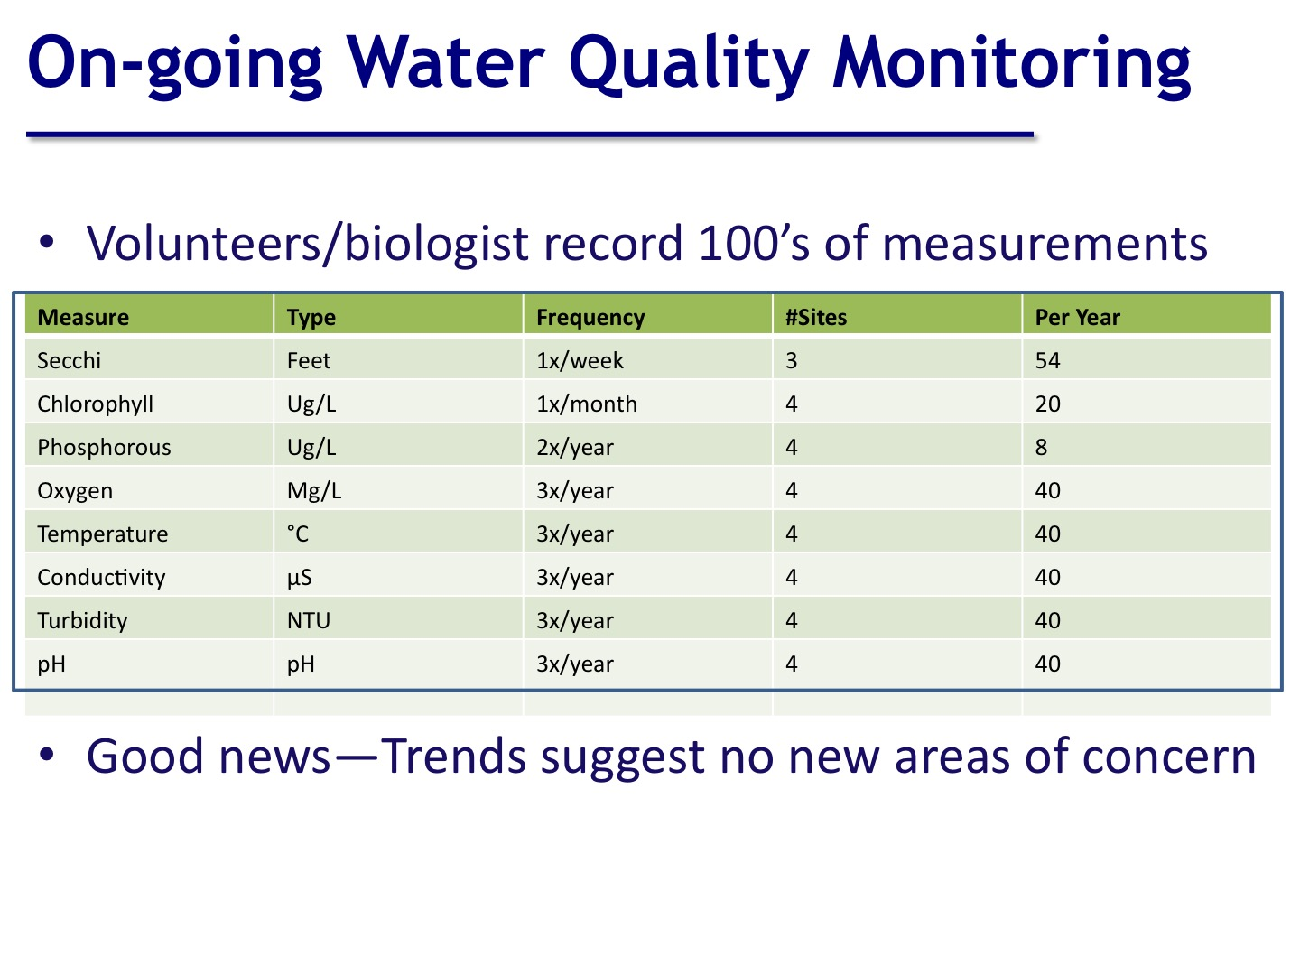

Slide 52
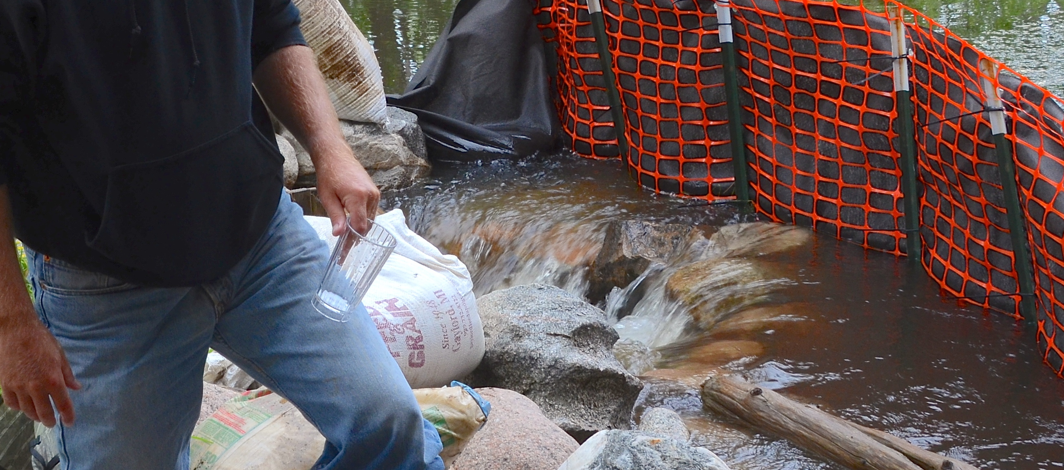
Hatlem Watershed Update
Determine two-year sedimentation rate
Working with property owner to obtain a new dam inspection report and hydro study to determine dam capacity
Notes:
Thank you for coming today…we will have a short business meeting, and then we will give you time to visit the displays and talk to the experts around the room who can give you great insight into the projects we support.

Slide 53
Water Level Committee Members
Chuck Andrews Mike McDonald
Dave Bohmer Bill Meserve (Chair)
Rick Fink Victor Peirce
Graig Halik Dave Pejsa
Alan Kasper John Peppler
John Kassarjian Vic Theiss
Calvin Killen Tim Westbay
John Lund Matt Wiesen

Slide 54
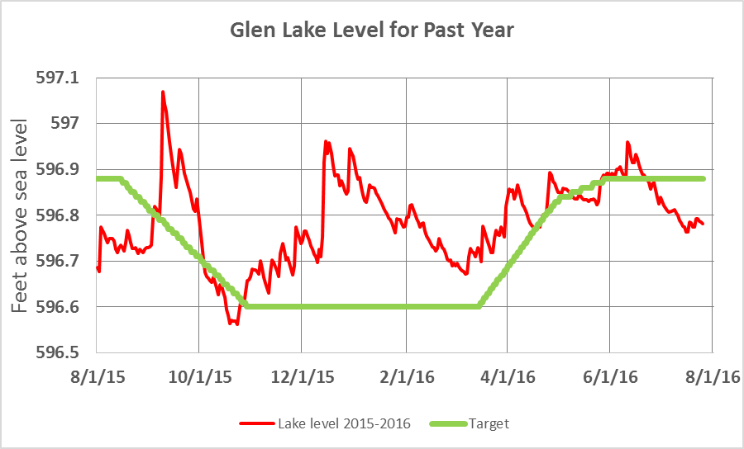
Water Level – Last 12 Months

Slide 55
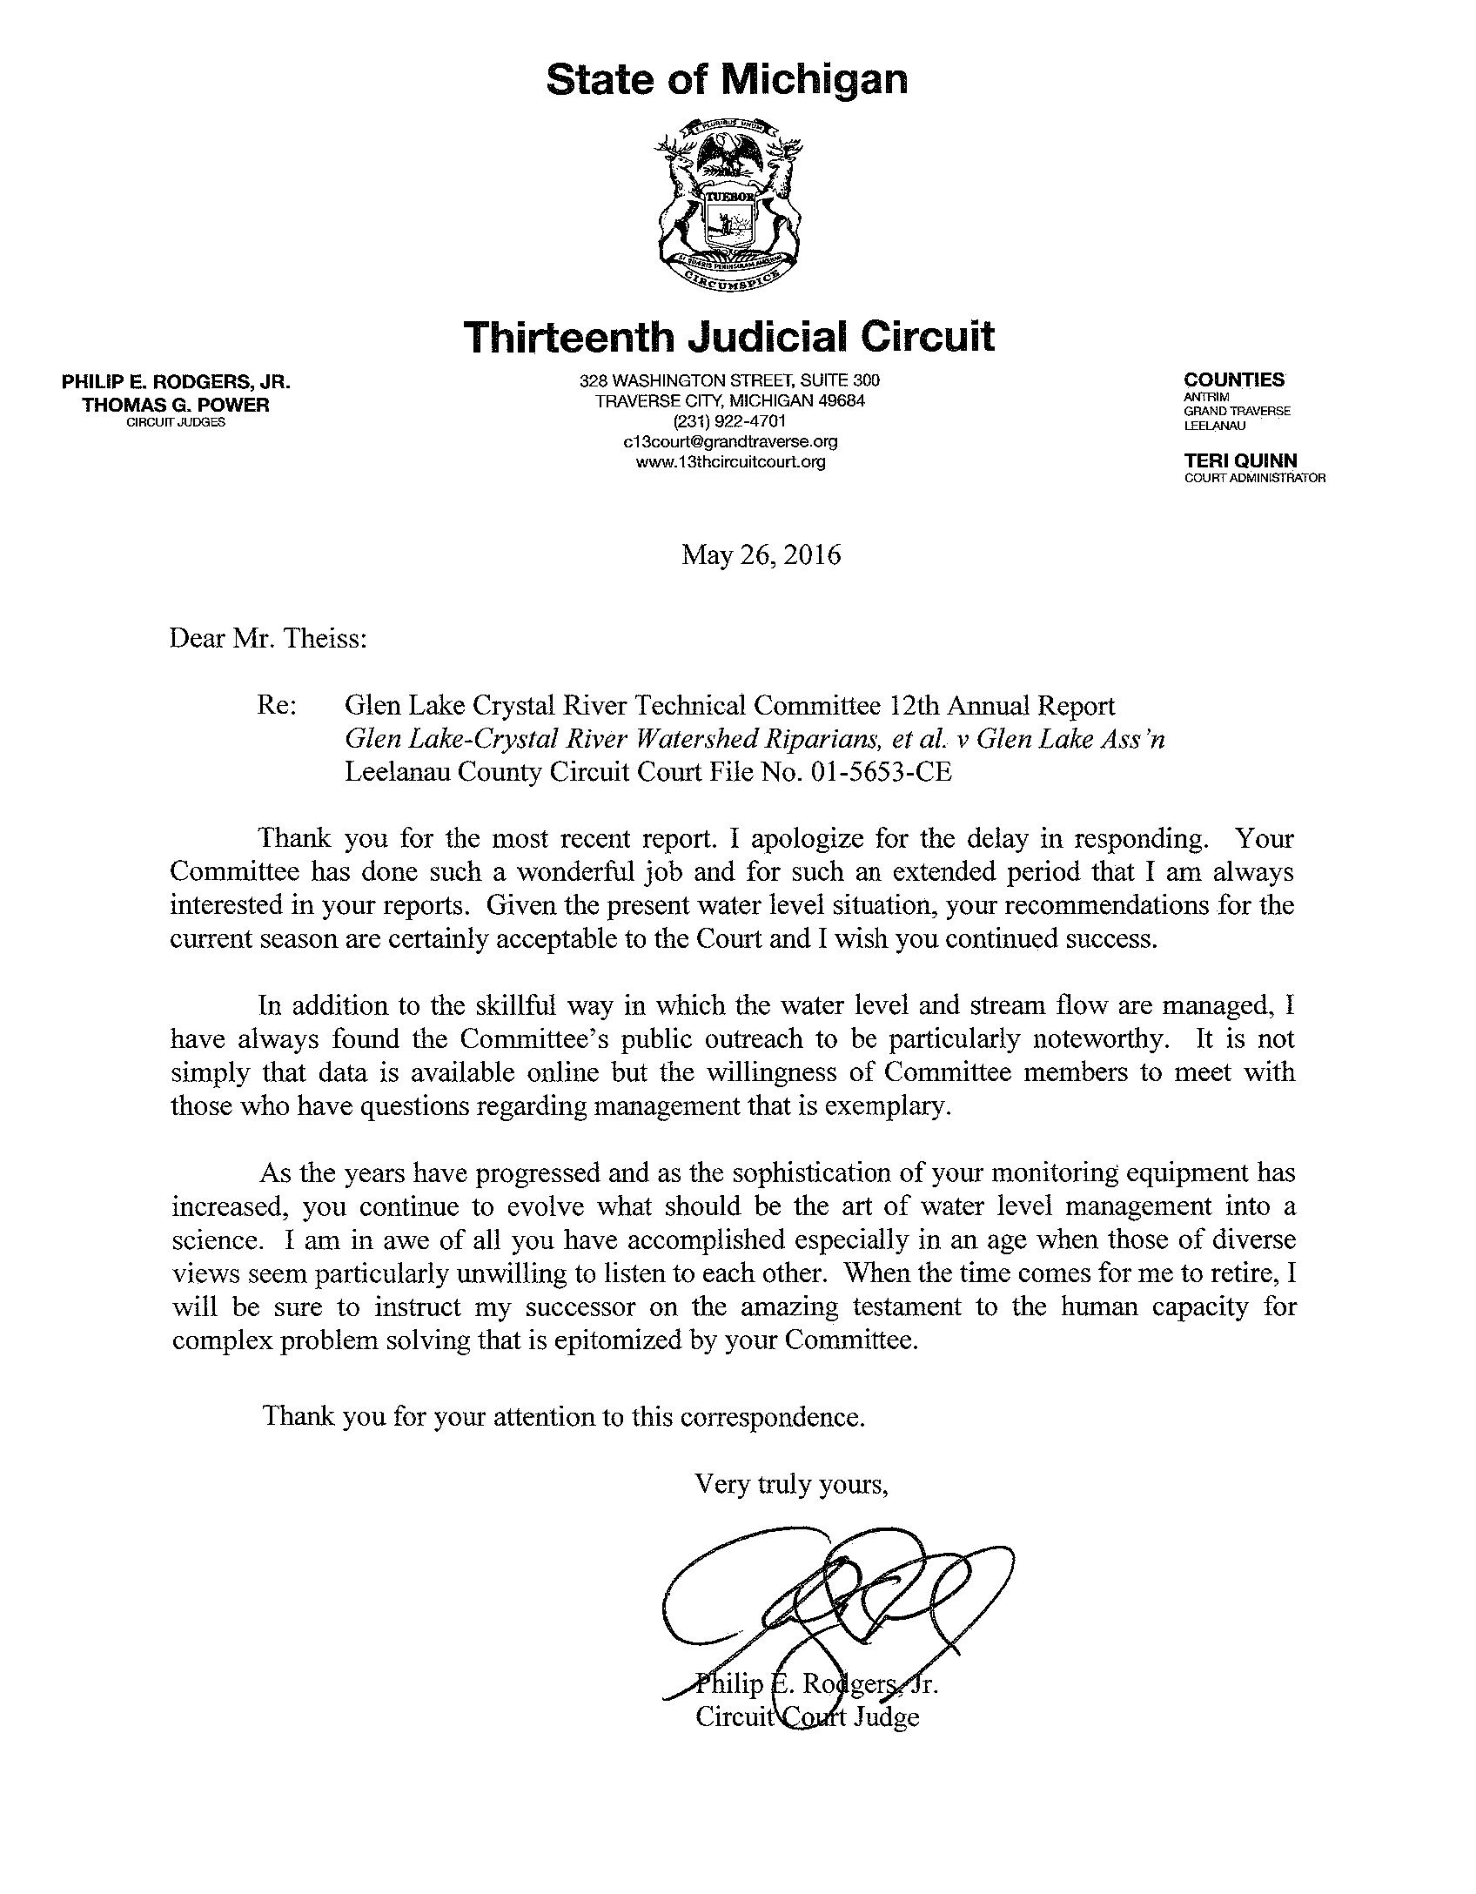
Letter from the Judge – 13th Judicial Circuit
“I have always found the Committee’s public outreach to be particularly noteworthy.”
“I am in awe of all you have accomplished…”
“…on the amazing testament to the human capacity for complex problem solving that is epitomized by your Committee.”

Slide 56
Fisheries, Wildlife, Recreation and Water Safety
John DePuy –Chair
Felicia Bloom
Ken Fosmore
Eric Laitala
Carl McBride
Bill Meserve
John Peppler
Ed Ricker
Brent Smith

Slide 57
Improve Fishing Generally
Working with DNR to review timing and location of fish plants
Exploring opening Mill Pond to Glen Lake
Reviewing strategies to control cormorants working with GTB (complicated by recent court order)
Notes:
Thank you for coming today…we will have a short business meeting, and then we will give you time to visit the displays and talk to the experts around the room who can give you great insight into the projects we support.

Slide 58
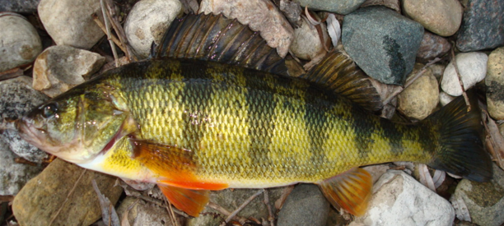
Focus on Perch
Working with DNR to determine if perch in Crystal River below dam can be moved into Glen Lake
Attempting to better understand why perch population decreasing (e.g. lack of food, cormorants, weed structure, pollutants, overfishing, etc.)
Exploring with DNR
“slot” size limit
Notes:
Thank you for coming today…we will have a short business meeting, and then we will give you time to visit the displays and talk to the experts around the room who can give you great insight into the projects we support.

Slide 59
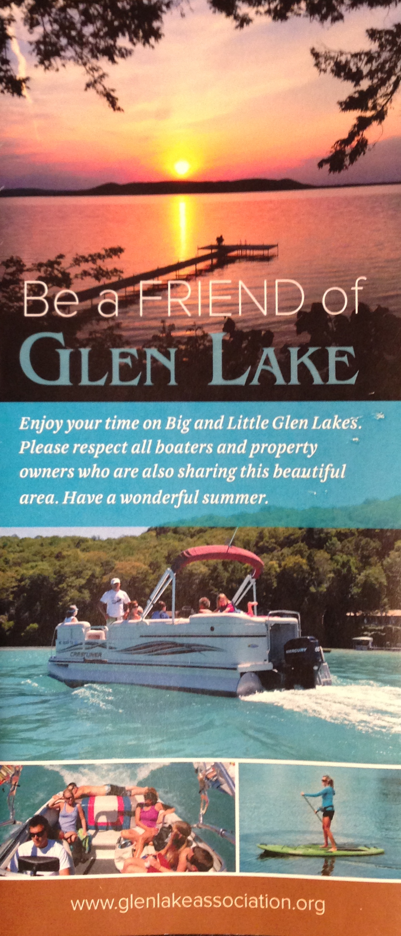
On-going Efforts
Continue working with riparians, boat rental businesses and sheriff to address large gathering on the lake
Work with landlords to provide materials for renters designed to improve boating etiquette on the lake
Provide “Be A Friend of Glen Lake” brochure at boat wash (boating regulations, public restrooms, important phone numbers, etc)
Address speed limits around the lake
Notes:
Thank you for coming today…we will have a short business meeting, and then we will give you time to visit the displays and talk to the experts around the room who can give you great insight into the projects we support.

Slide 60
Communications Committee
Bob Boles - Chairman
Sue Meserve - Newsletter
Cara Cassard - Website
Joan Kramps - Auxillary
Denny Becker - Ann Davey
Dale DeJager – Andy DuPont
Rob Karner – Sue Lake
Vick Peirce

Slide 61
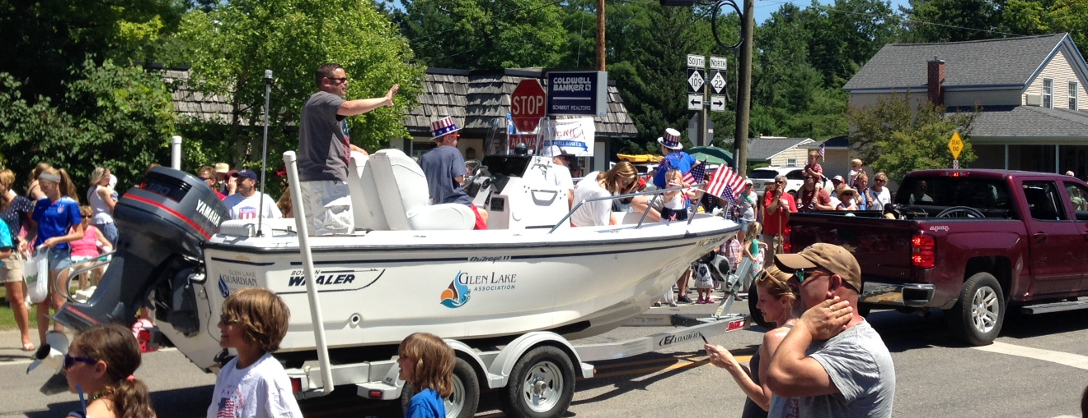
Communications Highlights
Developed and launched new GLA Website
Created new GLA Logo
Produced and distributed 3 Newsletters
Generated GLA promotional and advertising material
Coordinated media coverage
Participated in 4th of July parade

Slide 62
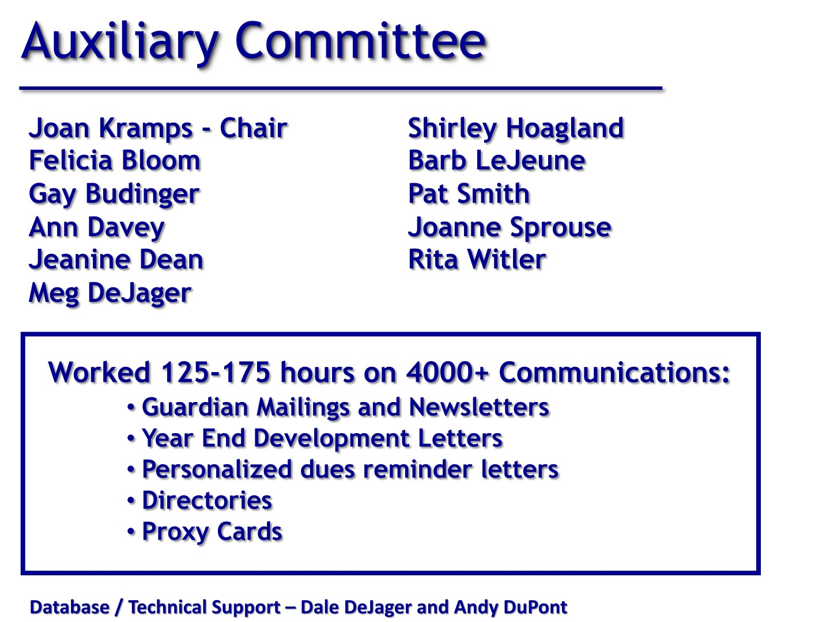

Slide 63
LR Planning Committee
Denny Becker- Chair
Bill Batterson
Jeanine Dean
Chip Hoagland
Rob Karner
Mike Litch
Sarah Litch
Tom Nelson
Charles Ofenlock
John Rockwood
Strengthen relationships with government entities—report semiannually to townships
  -Bill Meserve: Glen Arbor Township
  -Roy Pentilla: Empire Township
  -Carl Oleson: Kasson Township
Need for zoning gap analysis postponed until have a new township supervisor in Glen Arbor

Slide 64
Membership & Records
Membership - Cara Cassard & Bill Witler Co-Chairs
Jim Dutmers, Tom Dutmers, Ranae Ihme,
Jerry Morawski, Charlie Wallace
Records – Dale DeJager & Andy DuPont – Co-Chairs
Ann Davey, Sallyanne Morris
Membership giving at $109,000 is on pace to fully cover our operational costs for 2016 – Thank You!
Membership drive continues in 19 neighborhoods, seeking captains for 3 more
94% of funds from 76% of paying members who support at the sustaining or contributing level

Slide 65
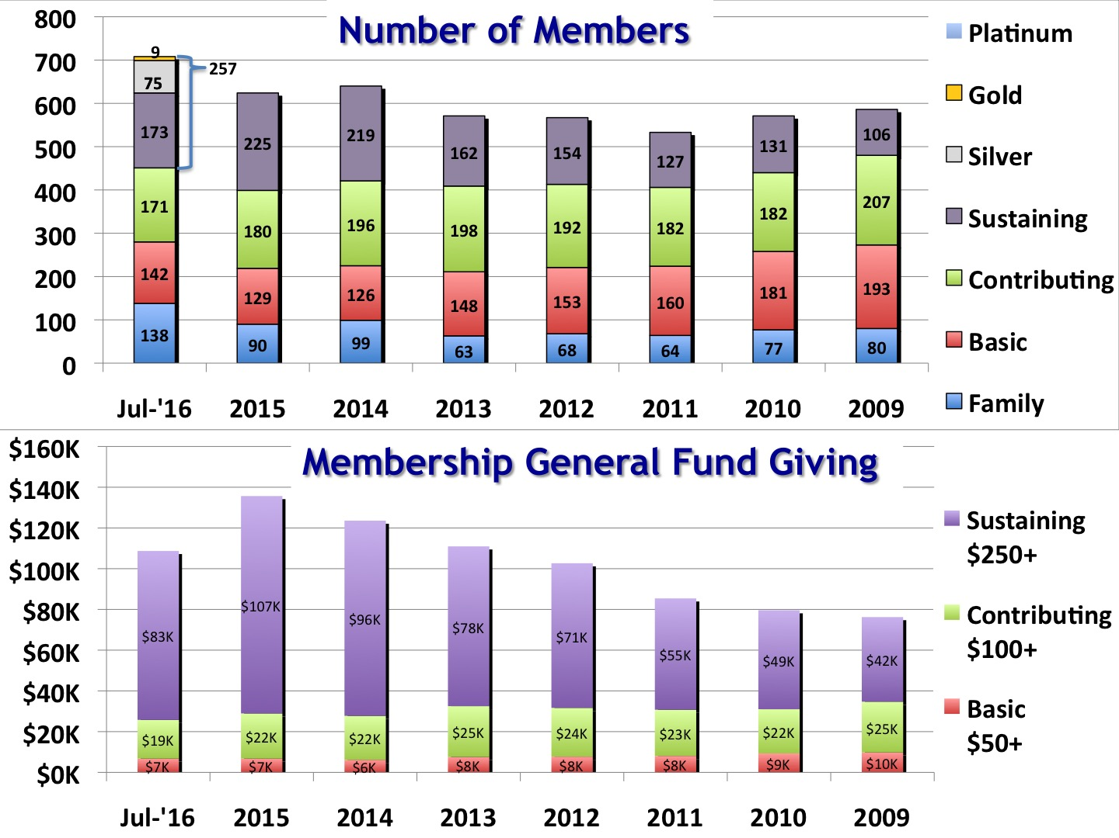

Slide 66
Neighborhood Captains
Zone Captain
Brooks Lake Kay Riegel
Burdickville Susan Haughn
Crystal River Joy Taylor
Dune Hwy 1 Ann Davey
Dune Hwy 2 Karen Zerrenner
Dunns Farm 1 Charlie Wallace
Dunns Farm 2 Tom Dutmers
Dunns Farm 3 Lori Lyman & Susan Haley
Dorsey Park Chris Shugart
Day Forest 1 Jerry Morawski
Day Forest 2 Denny Becker
Zone Captain
Fisher Lakes Andy DuPont
Glen Lake W1 Bruce Alton
Glen Lake W2 Ed Ricker
Glenmere Ed Murphy
Little Glen S1 Jim Chormann
Little Glen S2
Macfarlane 1 Dale DeJager
Macfarlane 2
Northwood 1 Magee Gordon
Northwood 2
Tamarack Cove Irene Bagby

Slide 67
Glen Lake Association
Stewardship Awards

Slide 68
Stewardship Awards
Recognize Riparians, Government Entities, Organizations and Individuals who have shown significant leadership in taking actions to preserve and protect the Glen Lake Watershed.
This year we recognize:
Michael and Lori Lyman
John Soderholm

Slide 69
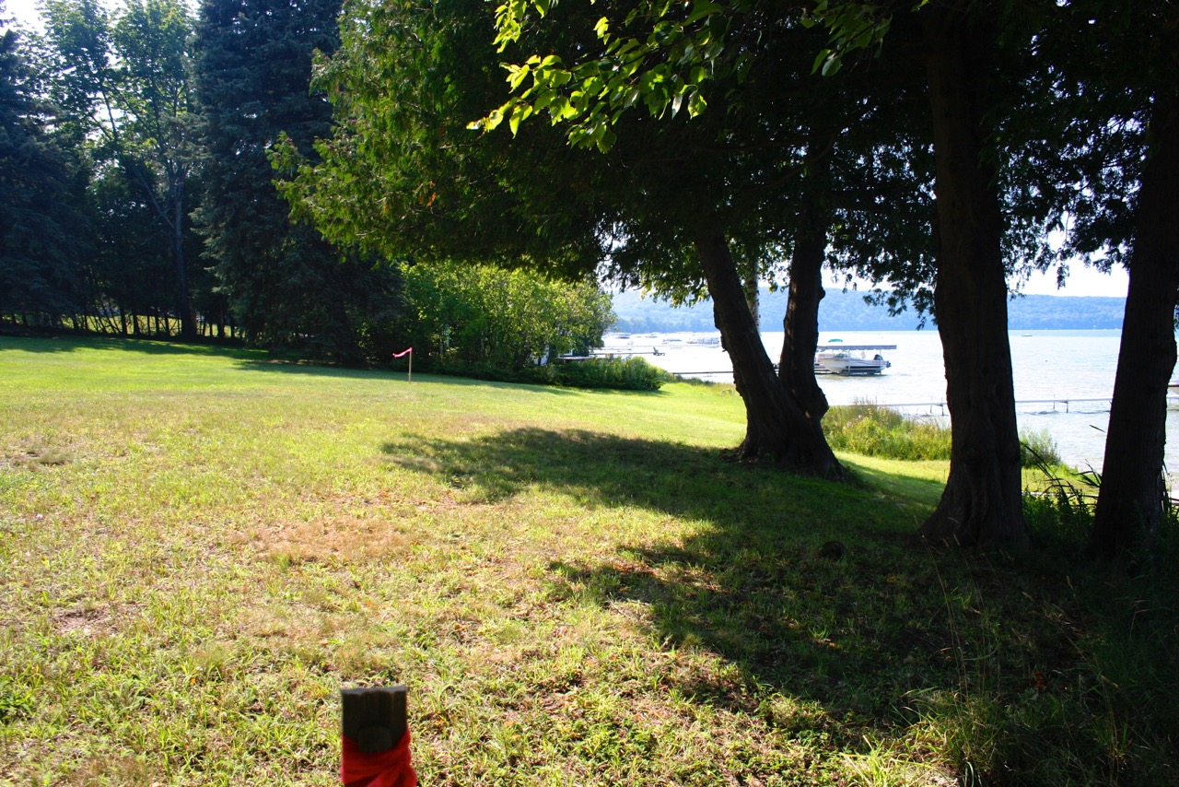
Lyman Property – Before Lakescaping

Slide 70
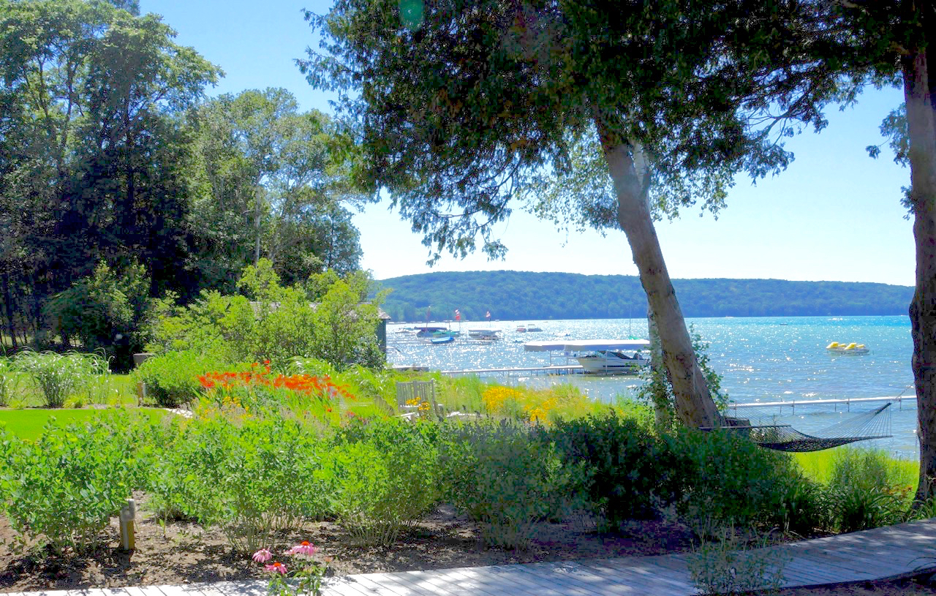
Lyman Property – After Lakescaping

Slide 71
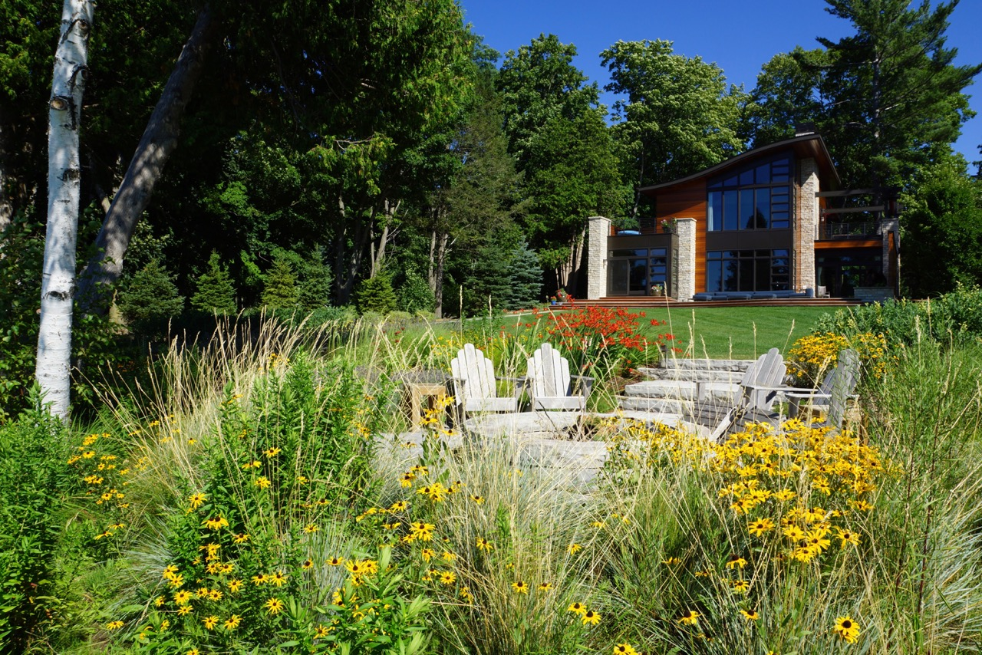
Lyman Property – After Lakescaping

Slide 72
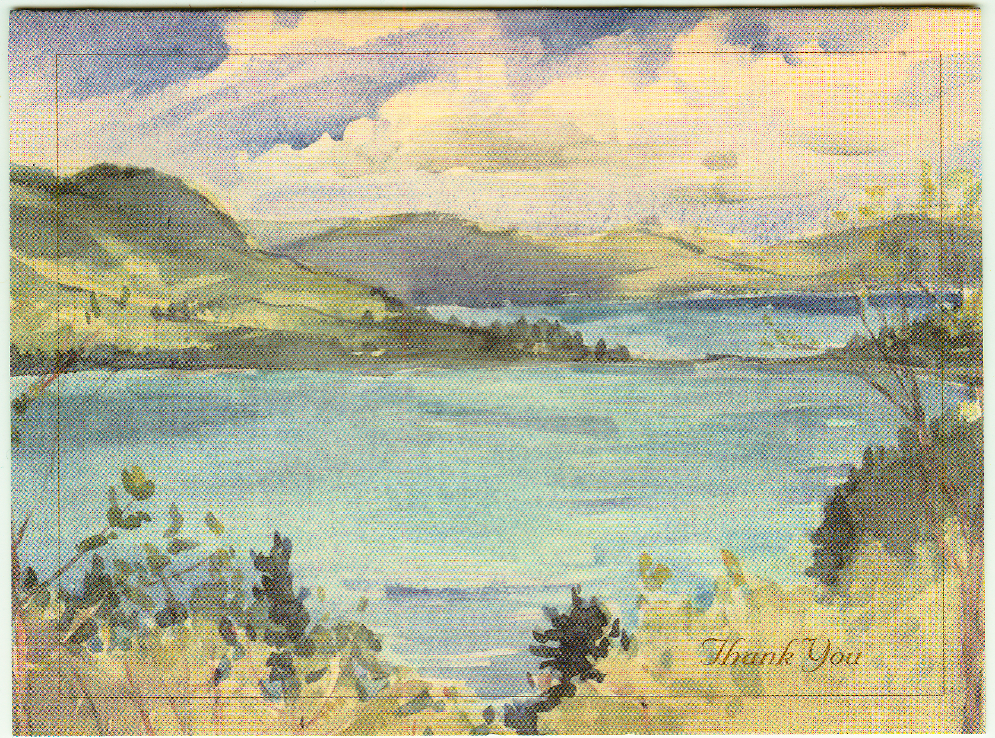
2016 Glen Lake Association Stewardship Award
Presented to
Michael and Lori Lyman
For
A Naturalized Shoreline and Wetland Protection which preserves the environmental integrity and water quality of the Glen Lake-Crystal River Watershed now and for future generations

Slide 73
2016 Glen Lake Association Stewardship Award
Presented to
John Soderholm
For
Outstanding service and leadership for 16 years to the Glen Lake-Crystal River Watershed, balancing community and development needs with protection of its lakes and streams.

Slide 74
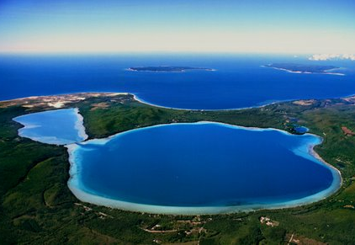
GLA Development Committee
Charles Ofenloch Co-Chairman
Sue Lake Co-Chairman
Bruce Alton
Denny Becker – Exofficio Member
David Cassard
Andra DuPont
Bob Berlacher
Richard Chormann
Jim Dutmers
David Herr
Lori Lyman
Roy Pentilla
Tim Unger
Bill Witler

Slide 75
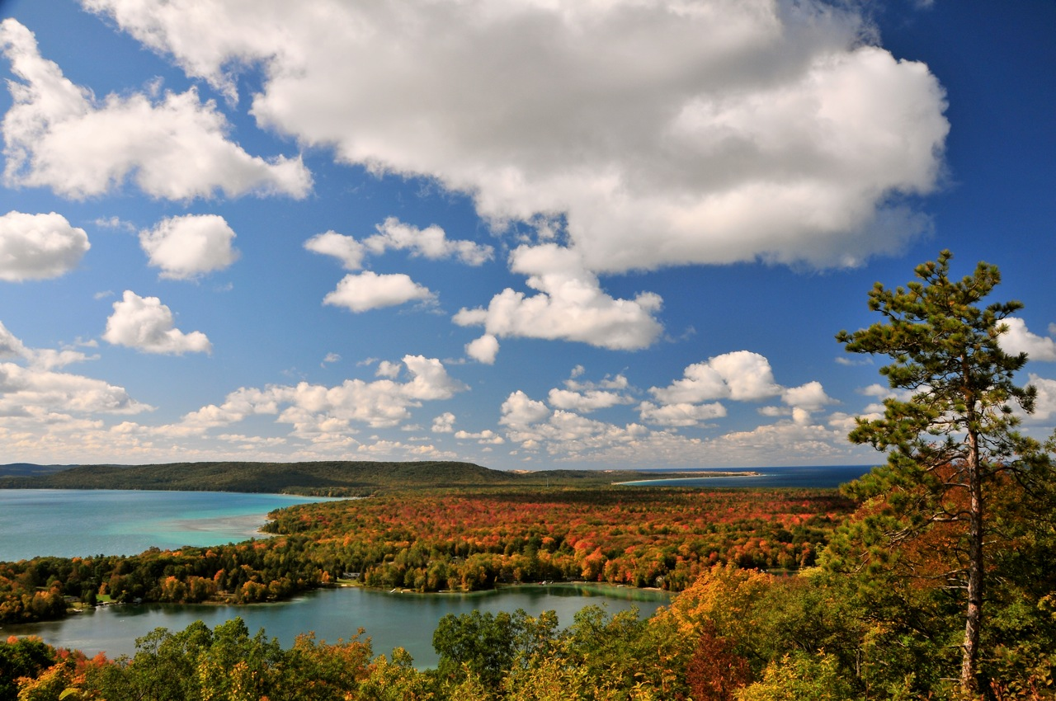
The goal of the Glen Lake Association Development Committee is to provide long term financial stability for the Association in order to preserve this fragile natural resource for generations to come and support its award winning watershed protection programs

Slide 76
Becoming A Legend
Through Planned Giving

Slide 77
GLA Legends
Support the Mission of the GLA
Include the GLA in your Estate Planning
Legends will be recognized annually for their support
We currently have twenty seven legends
Notify the Development Committee when you include the GLA in your will and, you too, will become a legend

Slide 78
GLA Legends
Bruce and Christie Alton
Sumner and Irene Bagby
Patrick and Cheryl Barry
Denny and Carole Becker
Bob and T Boles
David and Cara Cassard
Richard and Carolyn Chormann
James and Sharon Doyle
Jim and Susan Dutmers
Tom and Monica Dutmers
David and Maureen Herr
John and Carolyn Hoagland
Gary and Christine Peppler Johnson
Rob and Barb Karner
Thomas and Marilyn Klingaman
Joe and Sue Lake
Michael and Lori Lyman
Bill and Suzanne Meserve
Charles and Sara Ofenloch
Charles Patton
John Peppler
Dr. Richard and Barbara Schilling
Bill and Rita Witler

Slide 79
2016 GLA Legends
Jeff and Diane Hamilton
Joan Kramps
John and Ginny Rockwood
Tim and Sue Unger

Slide 80
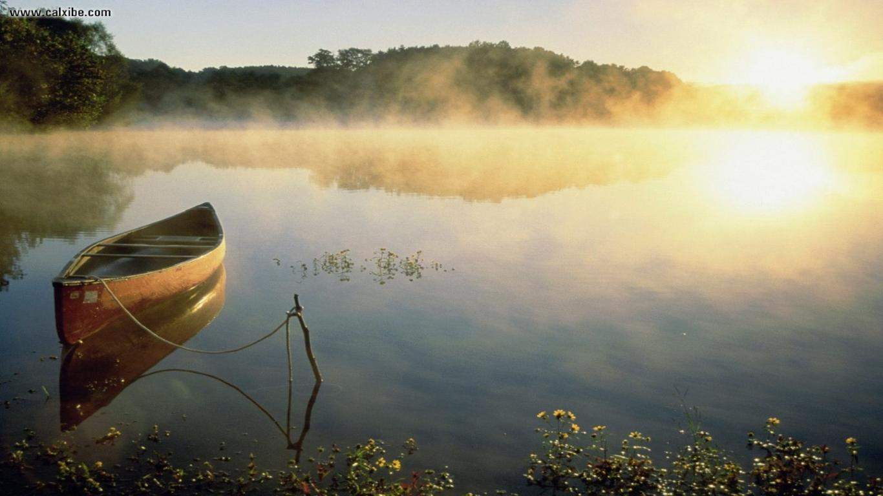
Leave a Legacy
Become a Legend

Slide 81
Board Nominations
Nominating Committee
-Andy Dupont—Chair
-Pam DePuy
-John Soderholm
-Bill Witler (non-voting/board liaison)
Board Nominations
-Tom Dutmers (fulfill two-year vacancy)
-David Hayes (three-year term)
-Vic Peirce (three-year term)
-Bill Meserve (second three-year term)
-Cal Killen (second three-year term)

Slide 82
Results of Election

Slide 83
Questions And Discussion

Slide 84
Motion to Adjourn

Slide 85
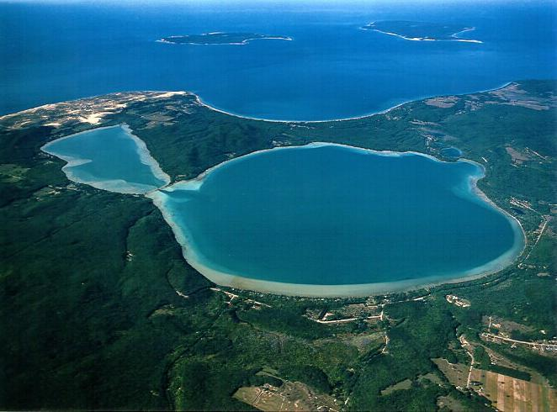
Social Lunch
Time to
share thoughts
and discuss ideas

