Slide 1
Glen Lake-Crystal River Watershed Project: A Long-Term Water Quality Protection Strategy
Tony Groves
Photo: Rob Karner

Slide 2
Glen Lake
Lake Area: 4,870 Acres
Maximum Depth: 130 Feet
Average Depth: 68 Feet
Shoreline Length: 10.5 Miles
Water Residence Time: 8.5 years
Top 1% of lakes statewide

Slide 3
Glen Lake-Crystal River Watershed
Total Watershed Area
29,721 Acres
46 Square Miles
Lakes to Land Ratio: 1 to 3.6

Slide 4
Watershed Characteristics
Development concentrated around lakes
Largely forested
Steep slopes
Soils highly permeable
Groundwater fed

Slide 5
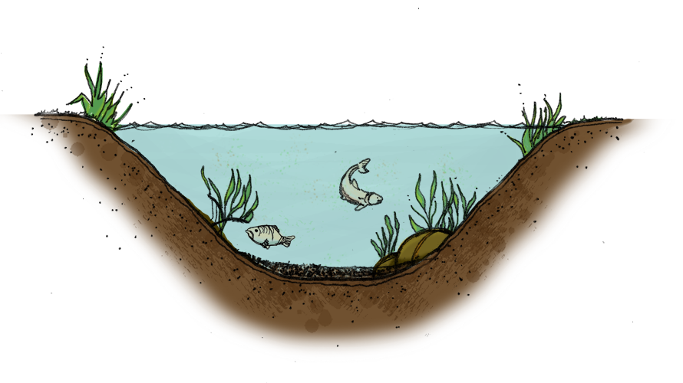
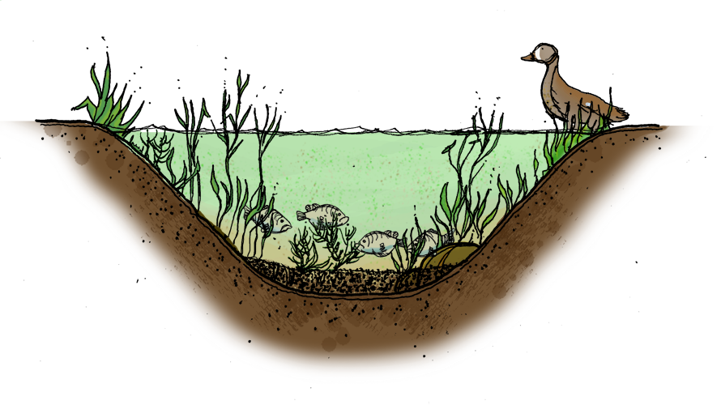
Water Quality
Oligotrophic
Mesotrophic
Glen Lake
Eutrophic

Slide 6
Temperature and Dissolved Oxygen
Oligotrophic Lakes
Eutrophic and Mesotrophic Lakes
Abundant oxygen below thermocline in summer
Low or no oxygen below thermocline in summer

Slide 7
Lake Sensitivity
Depth (feet) | Temperature (˚F) | Dissolved Oxygen (ppm)
0 | 55 | 11
3 | 55 | 10
10 | 55 | 10
13 | 55 | 11
23 | 55 | 10
26 | 55 | 10
33 | 55 | 10
43 | 55 | 10
49 | 55 | 10
56 | 55 | 10
62 | 55 | 10
69 | 55 | 10
75 | 53 | 10
82 | 48 | 11
89 | 46 | 11
95 | 44 | 10
102 | 44 | 9
108 | 43 | 8
115 | 42 | 2
121 | 42 | 0
128 | 42 | 0
EPA Clean Lakes Program Diagnostic/Feasibility Study (Keilty 1996)
Dissolved Oxygen: Deep-water “anoxia” and sediment phosphorus release
October 20, 2019: Complete anoxia at lake bottom!

Slide 8
Lake Sensitivity
Historical trends in water quality and erosion rates in Glen Lake (Fritz and Engstrom 1992)

Slide 9
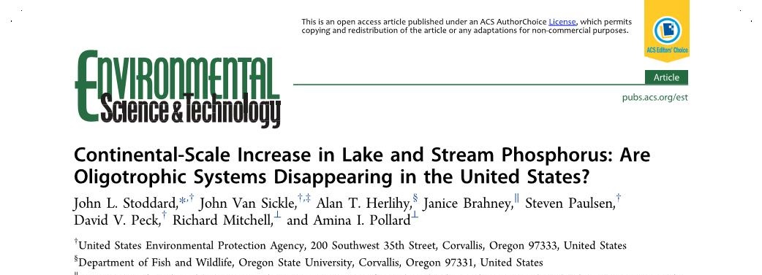
Lake Sensitivity
Are oligotrophic lakes disappearing? (Stoddard et al. 2016)

Slide 10
Lake Sensitivity
Natural shoreland buffers could help to reduce the impact of almost all the pollutants that currently threaten Glen Lake.
Direct overland runoff to the lake is insignificant as rainwater quickly infiltrates to the groundwater
Development in the watershed has a much greater potential to impact water quality

Slide 11
Glen Lake is …
Exceptional
Rare
Threatened
What can be done proactively to minimize development impacts?
Photo: Rob Karner

Slide 12
Planning and Zoning
Planning and zoning will guide development:
Type
Location
Density
Each township in watershed has its own master plan and zoning ordinance

Slide 13
Zoning Overlay District
In an overlay district, development must:
Meet all the conditions of the underlying zoning district and
The supplemental provisions of the overlay district

Slide 14
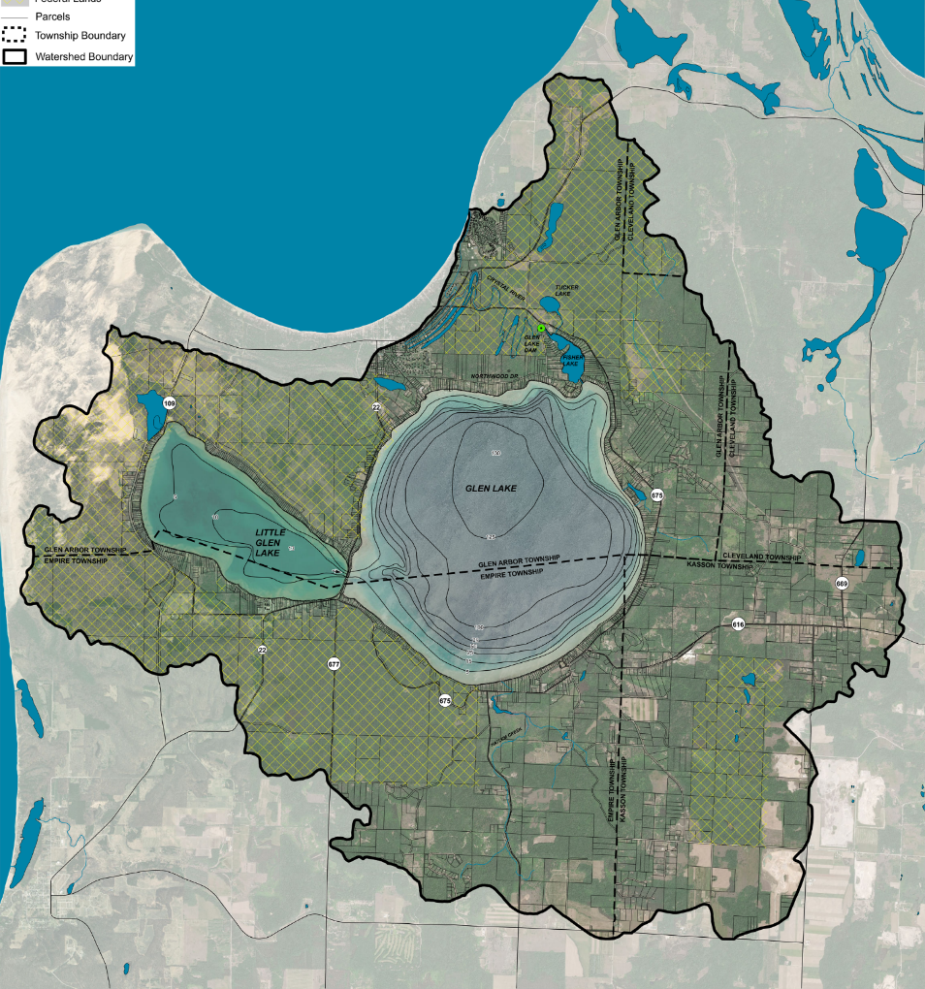
Glen Lake–Crystal River Watershed Overlay District
A watershed overlay district would provide:
Uniform water quality protection standards throughout the watershed
Long term water quality protection

Slide 15
Shoreline Vegetative Buffer
EPA National Lakes Assessment
Maine, Vermont, New Hampshire, Minnesota and Wisconsin have state-wide shoreland standards
Overlay requires 30-foot wide vegetative buffer

Slide 16
Shoreline Vegetative Buffer

Slide 17
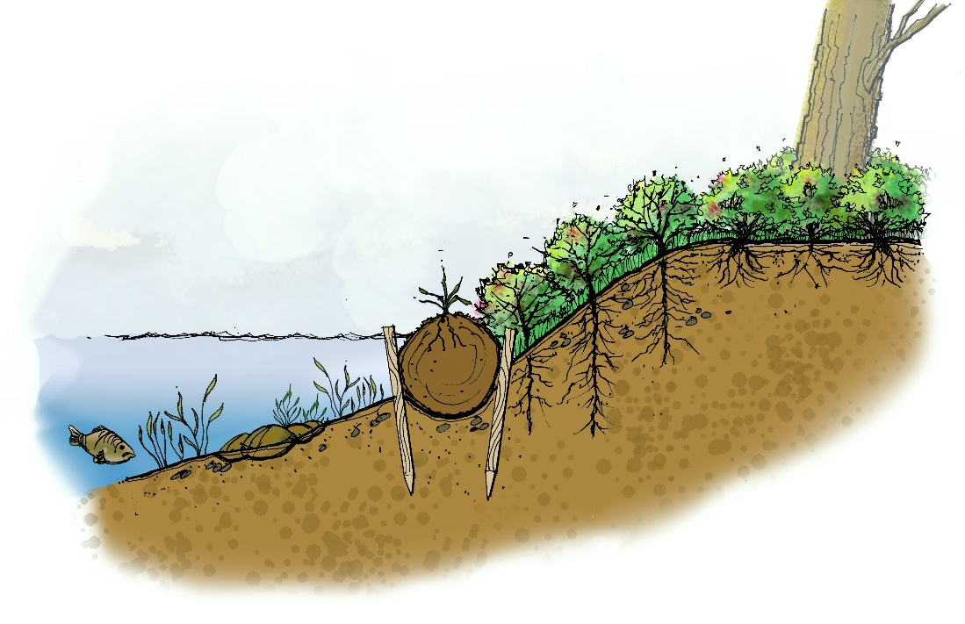
Seawalls
Increase scouring, erosion and turbidity
Deflect wave energy
Prevent the natural migration of aquatic life into and out of the water.
Overlay would discourage use of hardened seawalls

Slide 18
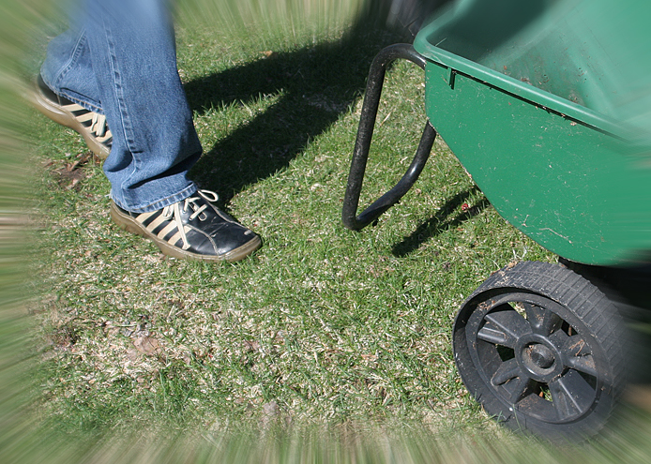
Fertilizer Use
Overlay would limit the use of phosphorus-laden lawn fertilizers that accelerate lake eutrophication.

Slide 19
Lot Coverage and Natural Vegetative Cover
Limit impervious surfaces to 25% of lot area
Maintain 30% natural vegetative cover
Promote the natural infiltration and recharge of groundwater in the watershed.
Natural ground cover
75-100% paved surfaces
40%
evaporation
30%
evaporation
10%
runoff
55%
runoff
10%
shallow
infiltration
5%
deep
infiltration
25%
shallow
infiltration
25%
deep
infiltration

Slide 20
Stormwater Management
Low Impact Development (LID) practices that promote the infiltration of stormwater and minimize runoff
Manage stormwater where it falls

Slide 21
Low Impact Development

Slide 22
Low Impact Development

Slide 23
Stormwater Management
County stormwater permit required before building permit is issued for…
Development within 500 feet of lake or stream
Earth changes of one acre or more
Subdivision development
Site Condominium developments

Slide 24
Steep Slopes
Designate lands with slopes 12% or greater as environmentally sensitive, require county stormwater permit.
40% natural vegetative cover
Preserve vegetation on hill tops and ridgelines

Slide 25
Approvals
Provide a process that ensures all development within the Glen Lake-Crystal River Watershed is reviewed to ensure full compliance with requirements of the overlay district

Slide 26
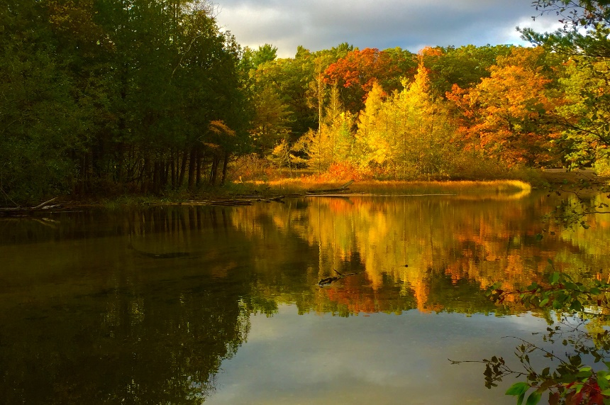
What’s Next?
Information Dissemination
Community forums and feedback
Community Survey
Acknowledgements
Glen Lake Association
Sarah Litch Memorial Fund
Rotary Charities
Grand Traverse Regional Community Foundation
Kasson Township
Empire Township
Glen Arbor Township

Slide 27
Questions?
I believe we should not measure human progress solely on the basis of what we have built, but also on what we have preserved and protected.
Governor William Milliken (August 2000)
Photo: Rob Karner

